Slide 1


<Name>
<Date>

Slide 2

Outline
Executive Summary
Introduction
Methodology
Results
Conclusion
Appendix

Slide 3
Executive Summary
Summary of methodologies
Data Collection
Data Wrangling
EDA With Data Visualization and SQL
Interactive Map with Folium
Dashboard with Plotly Dash
Predictive Analysis
Summary of all results
Exploratory Data Analysis Results
Interactive Analytics Demo in Screenshots
Predictive Analysis Results

Slide 4
Introduction
Project background and context
We predicted if the Falcon 9 first stage will land successfully. SpaceX advertises Falcon 9 rocket launches with a cost of 62 million dollars while other providers quote cost of 165 million dollars each.
Problems you want to find answers
Problems you want to find answers
What influences the successful landing of the rocket
The effect each relationship with certain rocket variables will impact in determining the success rate of a successful landing.
What conditions does SpaceX have to achieve to get the best results and ensure the best rocket success landing rate.

Slide 5

Section 1

Slide 6
Methodology
Executive Summary
Data collection methodology:
SpaceX Rest API and Web Scraping from Wikipedia
Perform data wrangling
One hot encoding data fields for machine learning and dropping irrelevant columns
Perform exploratory data analysis (EDA) using visualization and SQL
Plotting Scatter plots and bar graphs to show relationship between variables
Perform interactive visual analytics using Folium and Plotly Dash
Perform predictive analysis using classification models
Cross Validation with 10 folds

Slide 7
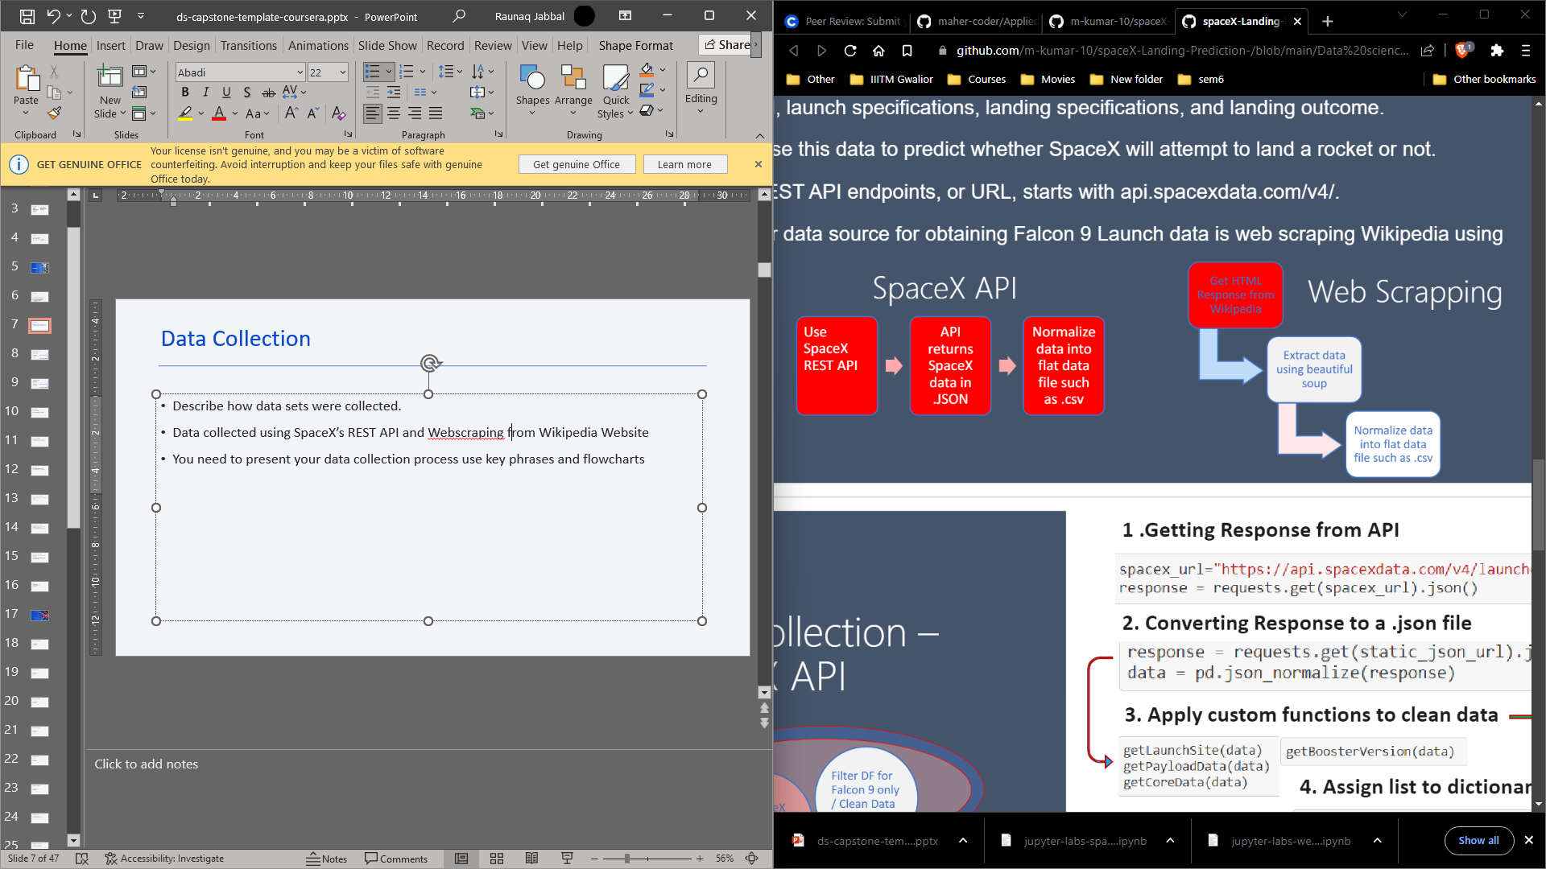
Data Collection
Describe how data sets were collected.
Data collected using SpaceX’s REST API and Webscraping from Wikipedia Website

Slide 8
Data Collection – SpaceX API
Requests.get() The API link, convert it into a JSON File, and clean that data and normalize it into a .csv file
https://github.com/raunaqjabbal/IBM-Project/blob/main/jupyter-labs-spacex-data-collection-api.ipynb

Slide 9
Data Collection - Scraping
Get response from HTML
Create BeautifulSoup object
Find table
Get column names
Append data to keys and convert to .csv
Create dictionary and convert to dataframe
https://github.com/raunaqjabbal/IBM-Project/blob/main/Data%20Collection%20with%20Web%20Scraping.ipynb

Slide 10
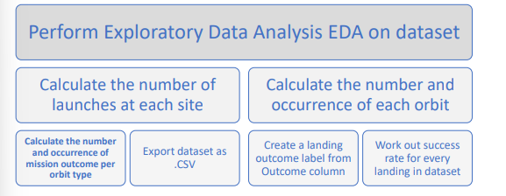
Data Wrangling
In the data set, there are several different cases where the booster did not land successfully. Sometimes a landing was attempted but failed due to an accident; for example, True Ocean means the mission outcome was successfully landed to a specific region of the ocean while False Ocean means the mission outcome was unsuccessfully landed to a specific region of the ocean. True RTLS means the mission outcome was successfully landed to a ground pad False RTLS means the mission outcome was unsuccessfully landed to a ground pad. True ASDS means the mission outcome was successfully landed on a drone ship False ASDS means the mission outcome was unsuccessfully landed on a drone ship. We mainly convert those outcomes into Training Labels with 1 means the booster successfully landed 0 means it was unsuccessful.
https://github.com/raunaqjabbal/IBM-Project/blob/main/labs-jupyter-spacex-Data%20wrangling.ipynb

Slide 11
EDA with Data Visualization
Scatter Graphs being drawn:
Flight Number VS. Payload Mass
Flight Number VS. Launch Site
Payload VS. Launch Site
Orbit VS. Flight Number
Payload VS. Orbit Type
Orbit VS. Payload Mass
Bar Graph being drawn: Mean VS. Orbit
Line Graph being drawn: Success Rate VS. Year
https://github.com/raunaqjabbal/IBM-Project/blob/main/EDA%20with%20Visualization%20lab.ipynb

Slide 12
EDA with SQL
• Displaying the names of the unique launch sites in the space mission
• Displaying 5 records where launch sites begin with the string 'KSC’
• Displaying the total payload mass carried by boosters launched by NASA (CRS)
• Displaying average payload mass carried by booster version F9 v1.1
• Listing the date where the successful landing outcome in drone ship was achieved.
• Listing the names of the boosters which have success in ground pad and have payload mass greater than 4000 but less than 6000
• Listing the total number of successful and failure mission outcomes
• Listing the names of the booster_versions which have carried the maximum payload mass.
• Listing the records which will display the month names, successful landing_outcomes in ground pad ,booster versions, launch_site for the months in year 2017
• Ranking the count of successful landing_outcomes between the date 2010-06-04 and 2017-03-20 in descending order.
https://github.com/raunaqjabbal/IBM-Project/blob/main/EDA%20with%20SQL%20lab.ipynb

Slide 13
Build an Interactive Map with Folium
To visualize the Launch Data into an interactive map. We took the Latitude and Longitude Coordinates at each launch site and added a Circle Marker around each launch site with a label of the name of the launch site.
We assigned the dataframe launch_outcomes(failures, successes) to classes 0 and 1 with Green and Red markers on the map in a MarkerCluster()
Using Haversine’s formula we calculated the distance from the Launch Site to various landmarks to find various trends about what is around the Launch Site to measure patterns. Lines are drawn on the map to measure distance to landmarks
Example of some trends in which the Launch Site is situated in.
•Are launch sites in close proximity to railways? No
•Are launch sites in close proximity to highways? No
•Are launch sites in close proximity to coastline? Yes
•Do launch sites keep certain distance away from cities? Yes
https://github.com/raunaqjabbal/IBM-Project/blob/main/Interactive%20Visual%20Analytics%20with%20Folium%20lab.ipynb

Slide 14
Build a Dashboard with Plotly Dash
Used Python Anywhere to host the website live 24/7 so your can play around with the data and view the data –
The dashboard is built with Flask and Dash web framework.
Graphs - Pie Chart showing the total launches by a certain site/all sites - display relative proportions of multiple classes of data. - size of the circle can be made proportional to the total quantity it represents.
Scatter Graph showing the relationship with Outcome and Payload Mass (Kg) for the different Booster Versions - It shows the relationship between two variables. - It is the best method to show you a non-linear pattern. - The range of data flow, i.e. maximum and minimum value, can be determined. - Observation and reading are straightforward.
https://github.com/raunaqjabbal/IBM-Project/blob/main/spacex_dash_app.py

Slide 15
Predictive Analysis (Classification)
BUILDING MODEL
• Load our dataset into NumPy and Pandas and transform Data
• Split our data into training and test data sets and check how many test samples we have
• Decide which type of machine learning algorithms we want to use
• Set our parameters and algorithms to GridSearchCV and fit our datasets into the GridSearchCV objects and train our dataset.
EVALUATING MODEL
• Check accuracy for each model
• Get tuned hyperparameters for each type of algorithms and plot Confusion Matrix
IMPROVING MODEL
• Feature Engineering and Algorithm Tuning
FINDING THE BEST PERFORMING CLASSIFICATION MODEL
• The model with the best accuracy score wins the best performing model
• In the notebook there is a dictionary of algorithms with scores at the bottom of the notebook.
https://github.com/raunaqjabbal/IBM-Project/blob/main/Machine%20Learning%20Prediction%20lab.ipynb

Slide 16
Results
Exploratory data analysis results
Interactive analytics demo in screenshots
Predictive analysis results

Slide 17

Section 2

Slide 18
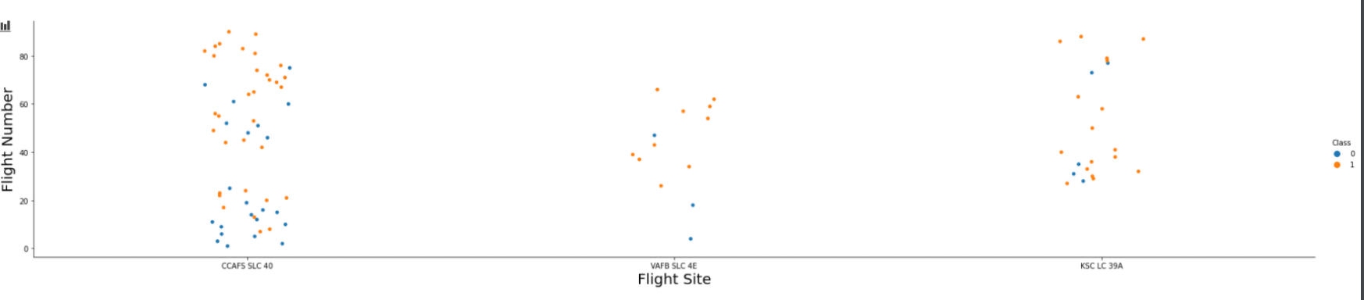
Flight Number vs. Launch Site
The more amount of flights at a launch site the greater the success rate at a launch site.

Slide 19
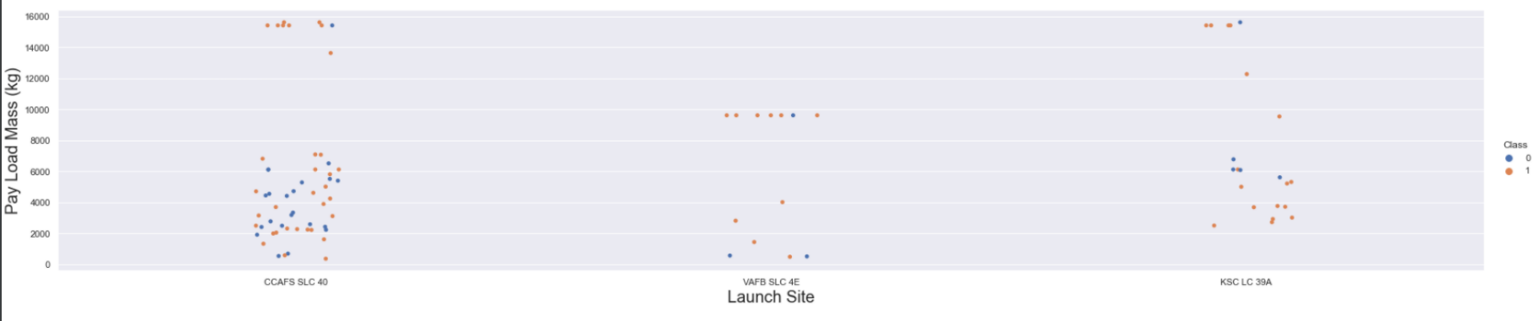
Payload vs. Launch Site
The greater the payload mass for Launch Site CCAFS SLC 40 the higher the success rate for the Rocket. There is not quite a clear pattern to be found using this visualization to make a decision if the Launch Site is dependant on Pay Load Mass for a success launch.

Slide 20
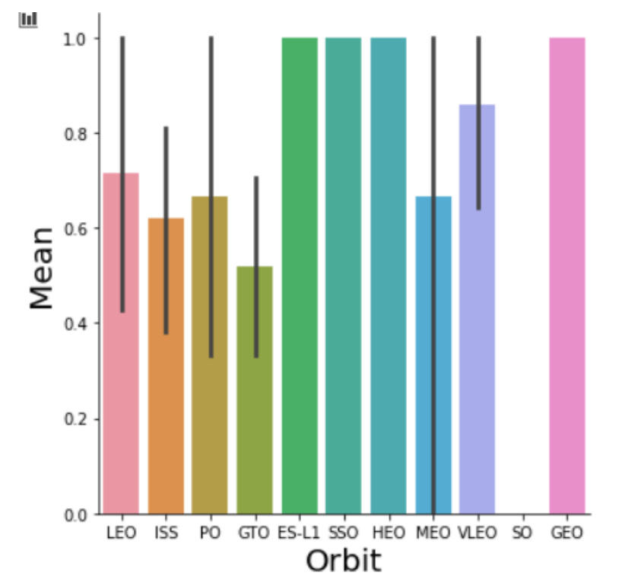
Success Rate vs. Orbit Type
Orbit GEO,HEO,SSO,ES-L1 has the best Success Rate

Slide 21
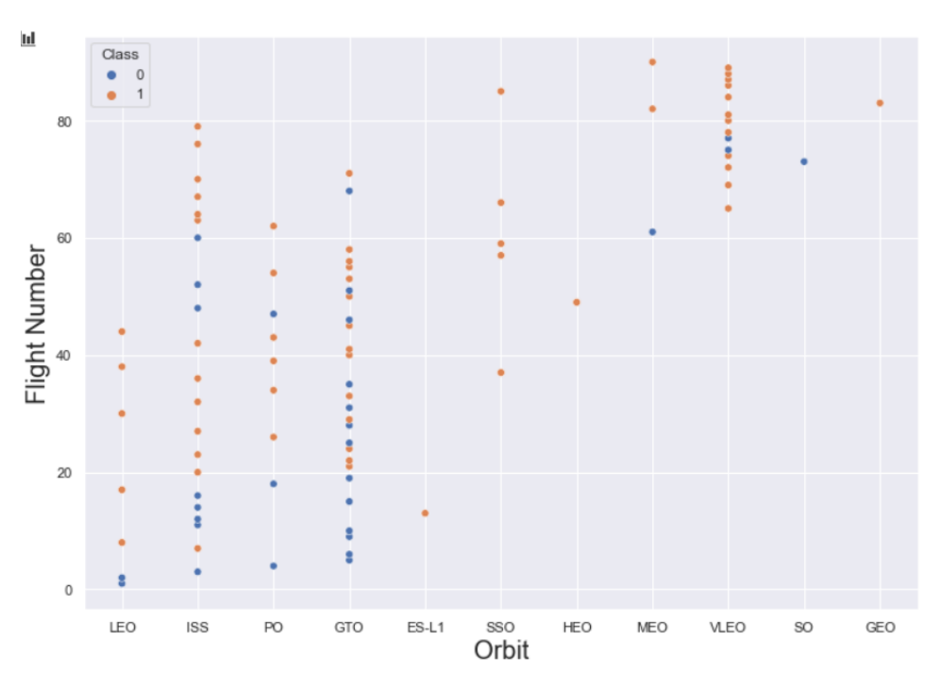
Flight Number vs. Orbit Type
You should see that in the LEO orbit the Success appears related to the number of flights; on the other hand, there seems to be no relationship between flight number when in GTO orbit.

Slide 22
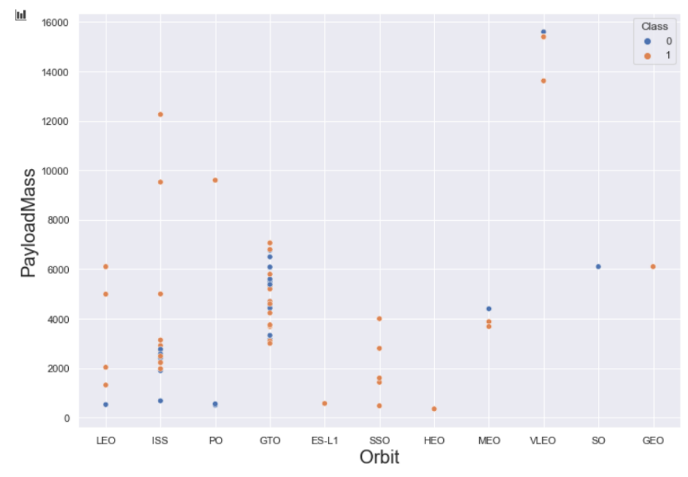
Payload vs. Orbit Type
You should observe that Heavy payloads have a negative influence on GTO orbits and positive on GTO and Polar LEO (ISS) orbits

Slide 23
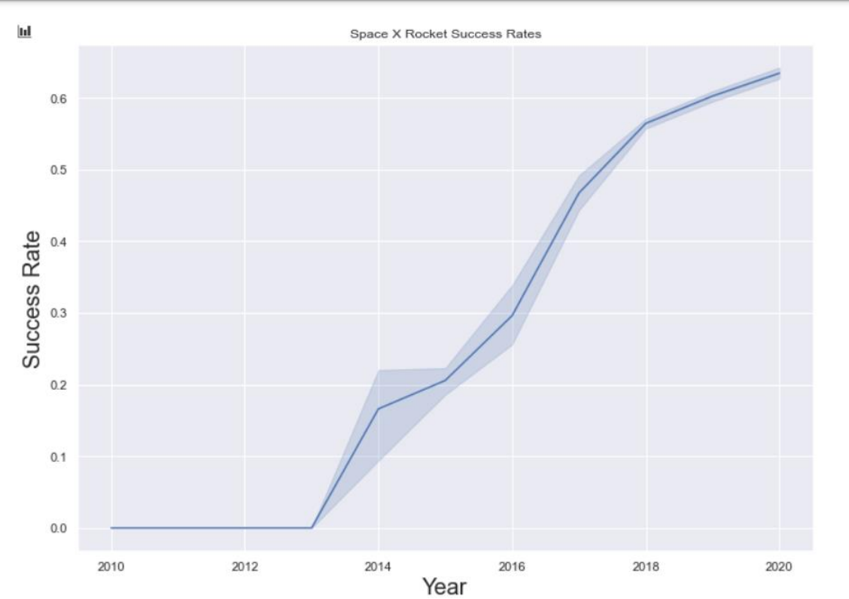
Launch Success Yearly Trend
you can observe that the success rate since 2013 kept increasing till 2020

Slide 24
All Launch Site Names
select DISTINCT Launch_Site from tblSpaceX
Unique Launch Sites CCAFS LC-40 CCAFS SLC-40 CCAFS SLC-40 KSC LC-39A VAFB SLC-4E
Using the word DISTINCT in the query means that it will only show Unique values in the Launch_Site column from tblSpaceX

Slide 25
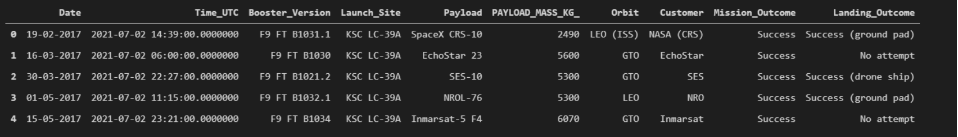
Launch Site Names Begin with 'CCA'
select TOP 5 * from tblSpaceX WHERE Launch_Site LIKE 'KSC%’
Using the word TOP 5 in the query means that it will only show 5 records from tblSpaceX and LIKE keyword has a wild card with the words ‘KSC%’ the percentage in the end suggests that the Launch_Site name must start with KSC.

Slide 26
Total Payload Mass
select SUM(PAYLOAD_MASS_KG_) TotalPayloadMass : 45596
Using the function SUM summates the total in the column PAYLOAD_MASS_KG_ The WHERE clause filters the dataset to only perform calculations on Customer NASA (CRS)

Slide 27
Average Payload Mass by F9 v1.1
select AVG(PAYLOAD_MASS_KG_) AveragePayloadMass from tblSpaceX where Booster_Version = 'F9 v1.1’ : 2928
Using the function AVG works out the average in the column PAYLOAD_MASS_KG_ The WHERE clause filters the dataset to only perform calculations on Booster_version F9 v1.1

Slide 28
First Successful Ground Landing Date
select MIN(Date) SLO from tblSpaceX where Landing_Outcome = ”Success (drone ship)” : 06-05-2016
Using the function MIN works out the minimum date in the column Date The WHERE clause filters the dataset to only perform calculations on Landing_Outcome Success (drone ship)

Slide 29
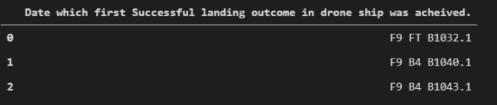
Successful Drone Ship Landing with Payload between 4000 and 6000
select Booster_Version from tblSpaceX where Landing_Outcome = 'Success (ground pad)’ AND Payload_MASS_KG_ > 4000 AND Payload_MASS_KG_ < 6000
Selecting only Booster_Version The WHERE clause filters the dataset to Landing_Outcome = Success (drone ship) The AND clause specifies additional filter conditions Payload_MASS_KG_ > 4000 AND Payload_MASS_KG_ < 6000

Slide 30
Total Number of Successful and Failure Mission Outcomes
SELECT(SELECT Count(Mission_Outcome) from tblSpaceX where Mission_Outcome LIKE '%Success%’) as Successful_Mission_Outcomes, (SELECT Count(Mission_Outcome) from tblSpaceX where Mission_Outcome LIKE '%Failure%’) as Failure_Mission_Coutcomes 100 Success 1 Failure
a much harder query I must say, we used subqueries here to produce the results. The LIKE ‘%foo%’ wildcard shows that in the record the foo phrase is in any part of the string in the records for example. PHRASE “(Drone Ship was a Success)” LIKE ‘%Success%’ Word ‘Success’ is in the phrase the filter will include it in the dataset

Slide 31
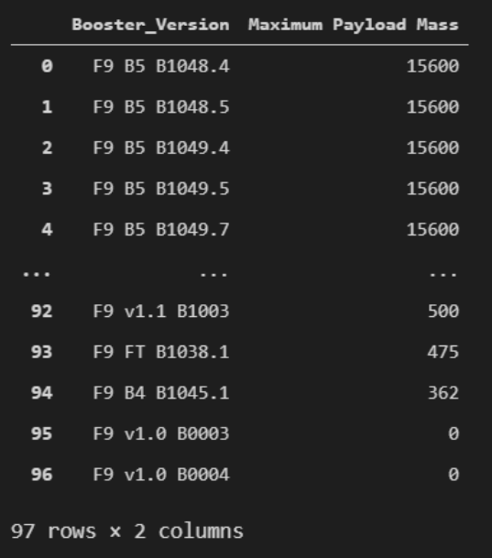
Boosters Carried Maximum Payload
SELECT DISTINCT Booster_Version, MAX(PAYLOAD_MASS _KG_) AS [Maximum Payload Mass] FROM tblSpaceX GROUP BY Booster_Version ORDER BY [Maximum Payload Mass] DESC
Using the word DISTINCT in the query means that it will only show Unique values in the Booster_Version column from tblSpaceX GROUP BY puts the list in order set to a certain condition. DESC means its arranging the dataset into descending order

Slide 32
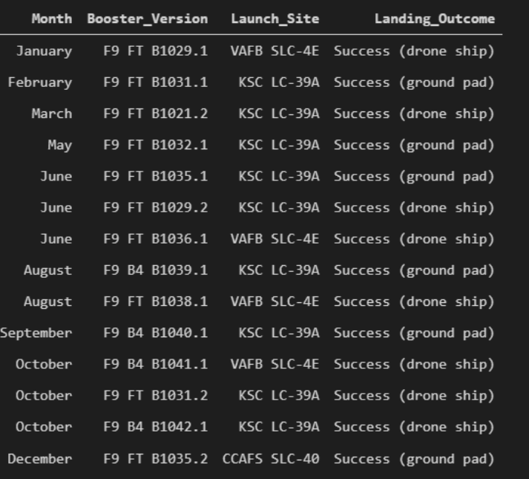
2015 Launch Records
SELECT DATENAME(month, DATEADD(month, MONTH(CONVERT(date, Date, 105)), 0) - 1) AS Month, Booster_Version, Launch_Site, Landing_Outcome FROM tblSpaceX WHERE (Landing_Outcome LIKE N'%Success%') AND (YEAR(CONVERT(date, Date, 105)) = ‘2015’)
a much more complex query as I had my Date fields in SQL Server stored as NVARCHAR the MONTH function returns name month. The function CONVERT converts NVARCHAR to Date. WHERE clause filters Year to be 2015

Slide 33
Rank Landing Outcomes Between 2010-06-04 and 2017-03-20
SELECT COUNT(Landing_Outcome) FROM tblSpaceX WHERE (Landing_Outcome LIKE '%Success%’) AND (Date > '04-06-2010’) AND (Date < '20-03-2017’) : 34
Function COUNT counts records in column WHERE filters data LIKE (wildcard) AND (conditions) AND (conditions)

Slide 34

Section 3

Slide 35
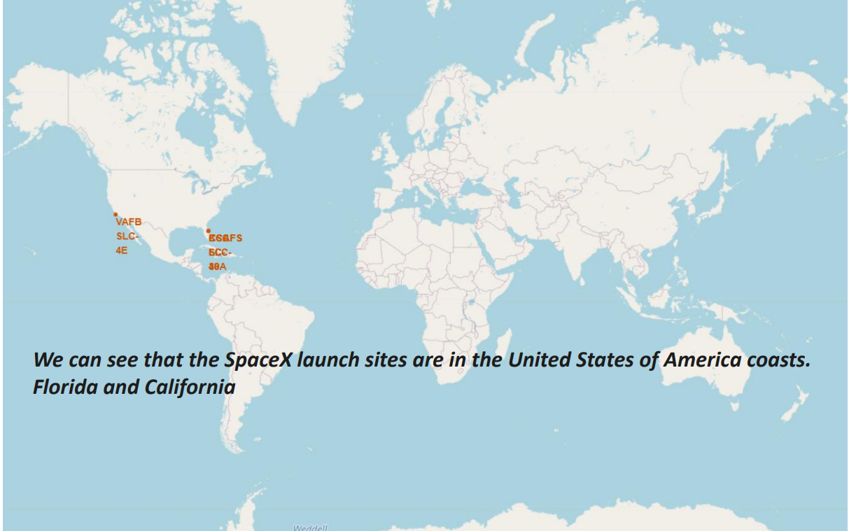
All launch sites global map markers

Slide 36
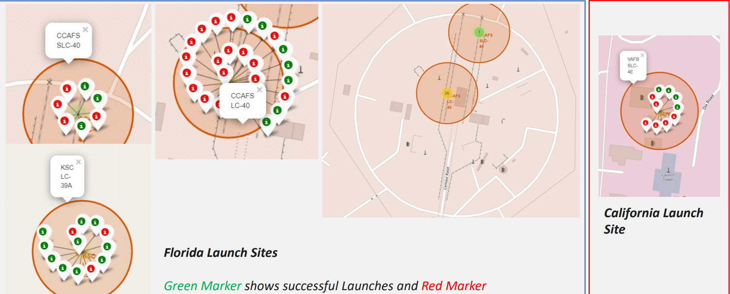
Colour Labelled Markers

Slide 37
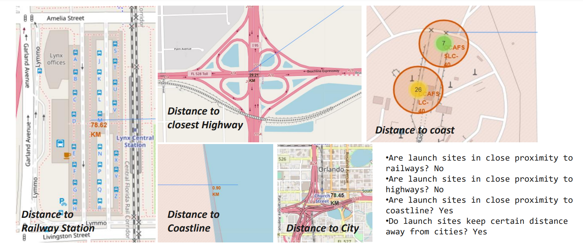
Working out Launch Sites distance to landmarks to find trends with Haversine formula using CCAFS-SLC-40 as a reference

Slide 38

Section 4

Slide 39
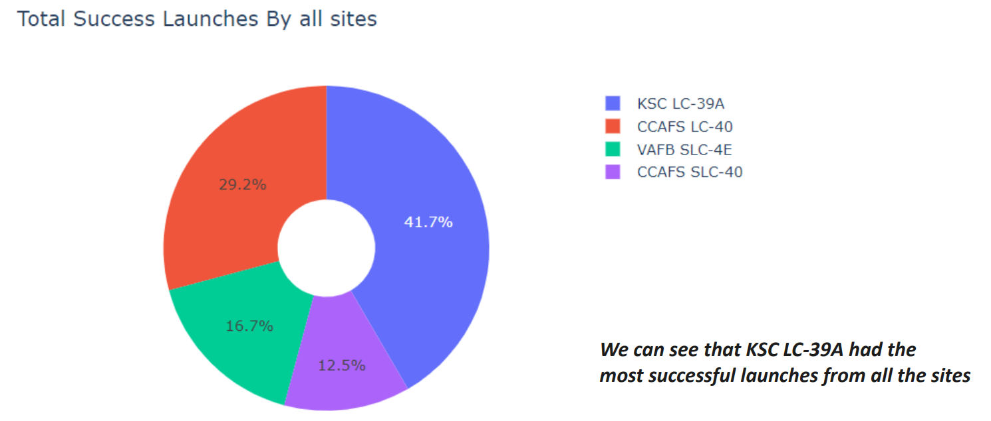
DASHBOARD – Pie chart showing the success percentage achieved by each launch site

Slide 40
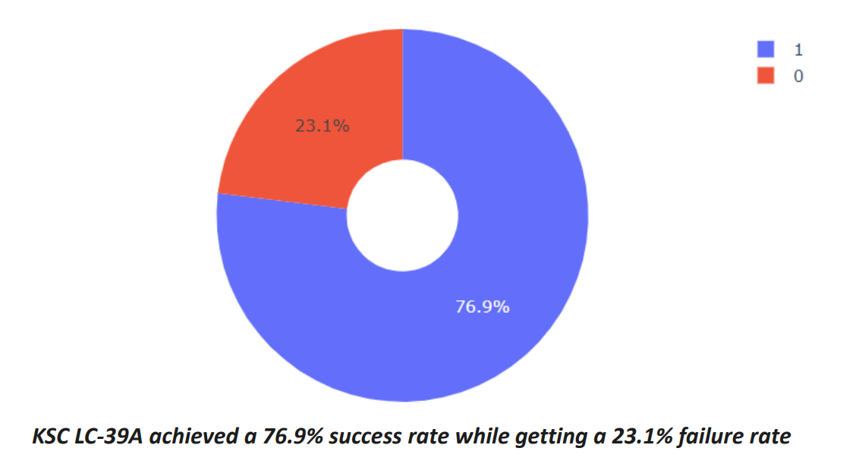
DASHBOARD – Pie chart for the launch site with highest launch success ratio

Slide 41
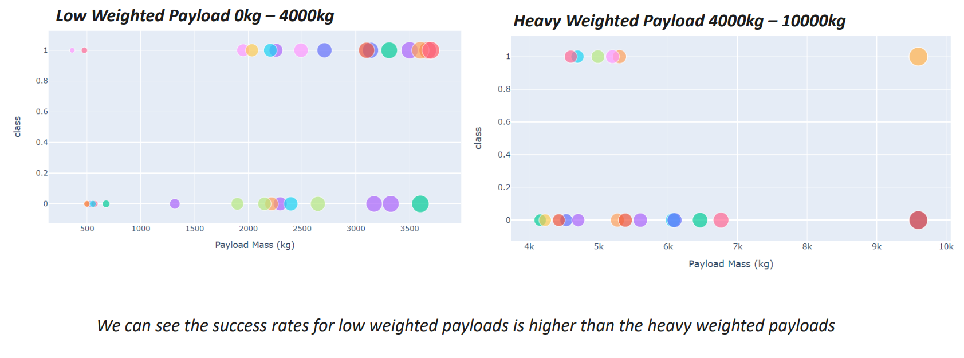
<Dashboard Screenshot 3>

Slide 42

Section 5

Slide 43
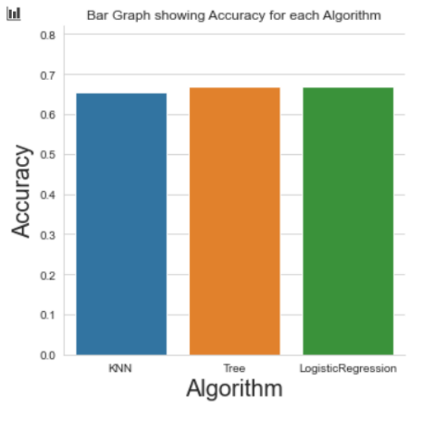
Classification Accuracy
As you can see our accuracy is extremely close but we do have a winner its down to decimal places! The tree algorithm wins!!
After selecting the best hyperparameters for the decision tree classifier using the validation data, we achieved 83.33% accuracy on the test data.

Slide 44
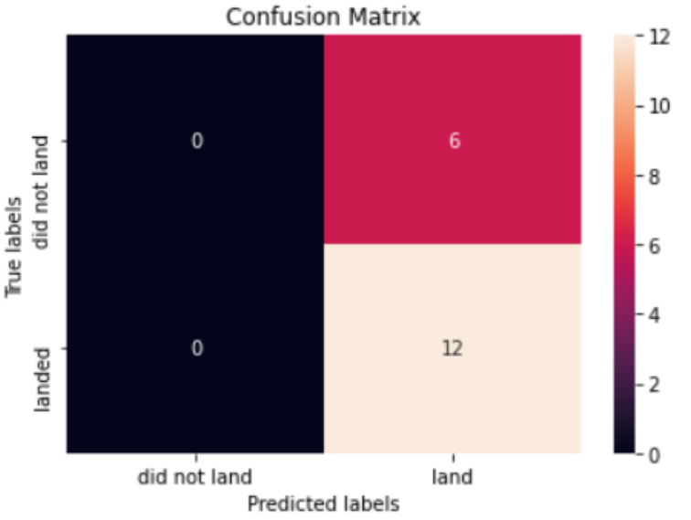
Confusion Matrix
Examining the confusion matrix, we see that Tree can distinguish between the different classes. We see that the major problem is false positives.

Slide 45
Conclusions
• The Tree Classifier Algorithm is the best for Machine Learning for this dataset
• Low weighted payloads perform better than the heavier payloads
• The success rates for SpaceX launches is directly proportional time in years they will eventually perfect the launches
• We can see that KSC LC-39A had the most successful launches from all the sites
• Orbit GEO,HEO,SSO,ES-L1 has the best Success Rate

Slide 46


